Slide 1


DEPARTMENT OF COMPUTER SCIENCE AND ENGINEERING
20CS7503 & DESIGN PROJECT – III
END SEMESTER PRACTICAL EXAMINATION- NOV / DEC 2025
REVIEW PRESENTATION
Batch No.:19
Date:29.11.2025
Session:AN

Slide 2
OBJECTIVE OF THE PROJECT
1. Create an intelligent, invisible hand-like system that allows users to control a computer through eye blinks, facial expressions, and head movements, removing the need for physical input devices.
2. Ensure the solution is inclusive and user-friendly, specifically supporting individuals with limited mobility to achieve independent digital interaction.
3. Implement LSTM-based gesture recognition to differentiate intentional actions from involuntary movements, improving accuracy, reducing false commands, and adapting to each user’s behavior over time.

Slide 3
INTRODUCTION
1. The project is designed to assist individuals with physical disabilities by enabling computer control through facial gestures.
2. It recognizes facial gestures such as eye blinks, smiles, and head movements to replace common mouse functions like cursor movement and clicks.
3. It uses computer vision tools like OpenCV, MediaPipe, along with an LSTM machine learning model, to recognize facial gestures accurately in real time.
4. Real-time responsiveness ensures smooth and practical use, making the system suitable for everyday digital tasks.

Slide 4
LITERATURE SURVEY
TITLE OF PAPER | AUTHOR(S) | PAPER GIST | TECHNOLOGY USED
Cursor Control Using Facial Gestures | Chau & Betke | Mouse pointer control using facial gestures | HCI, Facial Gesture Tracking
Head Pose Estimation in Computer Vision | Murphy-Chutorian & Trivedi | Robust head orientation tracking | OpenCV, Head Pose Estimation
Face Gesture Controlled Mouse | Kumar & Bhuvaneshwari | Eye blink recognized for clicking. | OpenCV Face Tracking, Eye Blink Detection
Eye Blink Detection using Facial Landmarks | Soukupová & Čech | Blink detection using EAR thresholding | EAR (Eye Aspect Ratio), Face Landmarks
MediaPipe – ML Pipeline Framework | Lugaresi et al. | Real-time ML landmark extraction | MediaPipe Face Mesh
Implementation of a Virtual Mouse Based on Facial Expressions | Satish R. & Nandhini R. | Facial expression-based virtual mouse | Facial Expression Recognition + Webcam

Slide 5
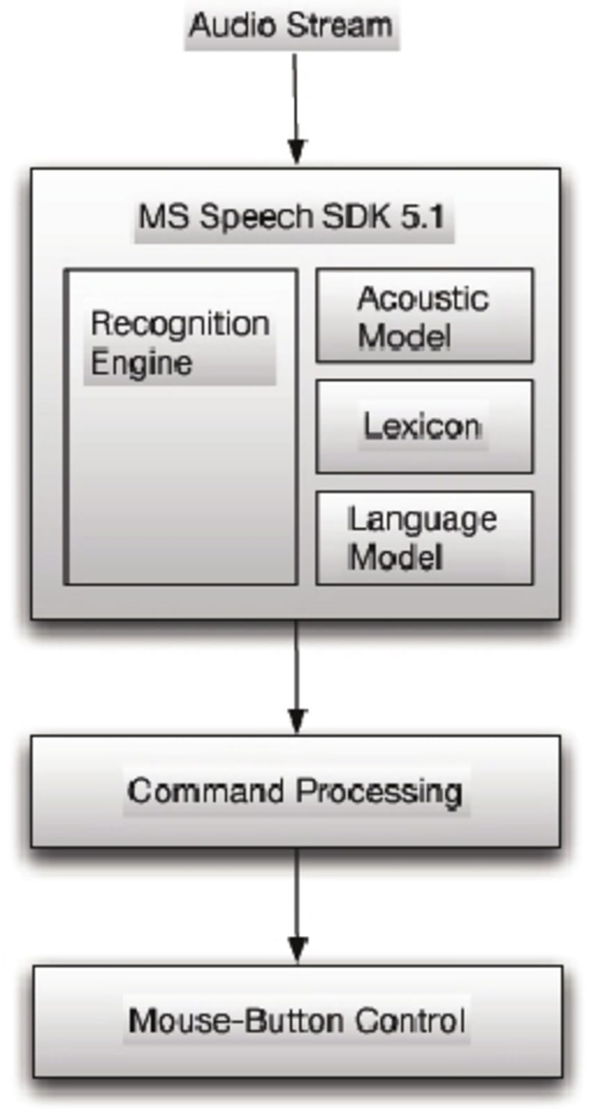
EXISTING SYSTEM ARCHITECTURE

Slide 6
PROBLEM IDENTIFICAITON
1. Physically challenged individuals require an alternative method to interact with computers without relying on traditional input devices like a mouse or keyboard.
2. There is a growing need for hands-free computer control that enhances accessibility and independence in human–computer interaction.
3. Facial gestures such as eye blinks and head movements offer a natural and intuitive way to control the cursor, but require accurate detection and interpretation.
4. Implementing such a system would improve usability, accessibility, and inclusiveness, especially for users with physical disabilities or limited mobility.
5. An AI-based approach is required to ensure smooth and precise cursor movement.

Slide 7
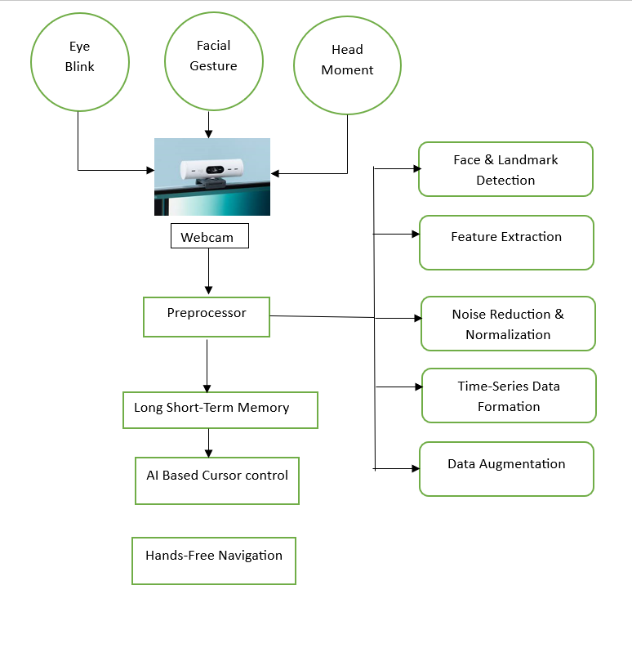
PROPOSED SYSTEM ARCHITECTURE

Slide 8
SOFTWARE AND HARDWARE REQUIREMENTS
HARDWARE
1. Processor – Intel i3
2. Computer/Laptop with minimum 8GB RAM
3. Webcam
4. Proper Lighting Source
SOFTWARE
1. Backend: Python 3.8+
2. Libraries: OpenCV, MediaPipe, PyAutoGUI, NumPy
3. Frontend: OpenCV live video window
4. Additional Model: MediaPipe FaceMesh for facial landmark detection

Slide 9
MODULES
1. Input Acquisition Module
2. Preprocessing Module
3. LSTM-Based Gesture Prediction Module
4. Execution Module
5. Performance Metrics Module

Slide 10
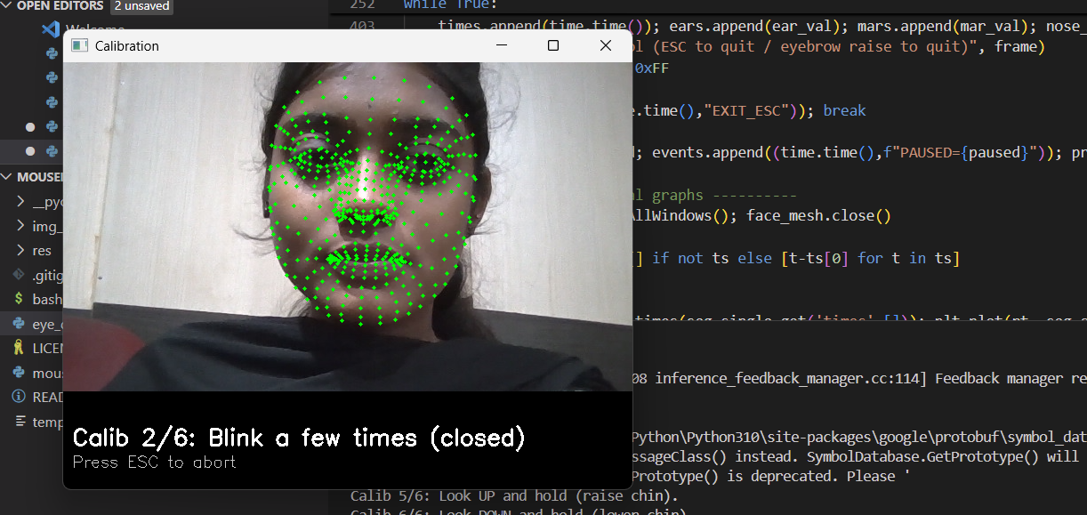
IMPLEMENTATION OF MODULE-1
1. Captures real-time video feed from the webcam using OpenCV
2. Detects and tracks facial landmarks using MediaPipe FaceMesh

Slide 11
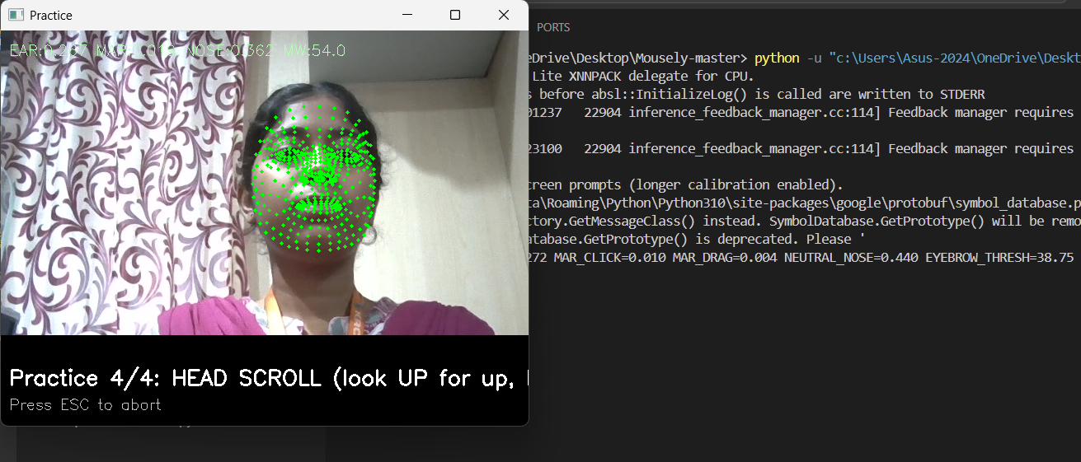
IMPLEMENTATION OF MODULE-2
1. Converts the captured frame to grayscale and applies CLAHE for contrast enhancement.
2. Extracts essential facial features like eyes and mouth regions, and computes EAR (Eye Aspect Ratio) and MAR (Mouth Aspect Ratio).

Slide 12
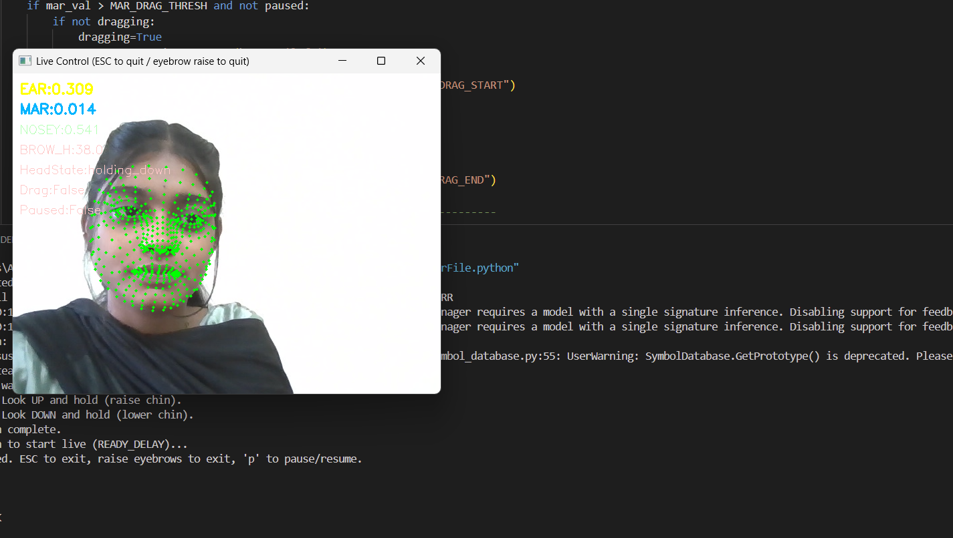
IMPLEMENTATION OF MODULE-3
1. Uses temporal sequences of EAR, MAR, and facial point data to train an LSTM (Long Short-Term Memory) model for gesture classification.
2. Predicts gestures such as left blink, right blink, and mouth open based on time-series facial movement patterns.

Slide 13
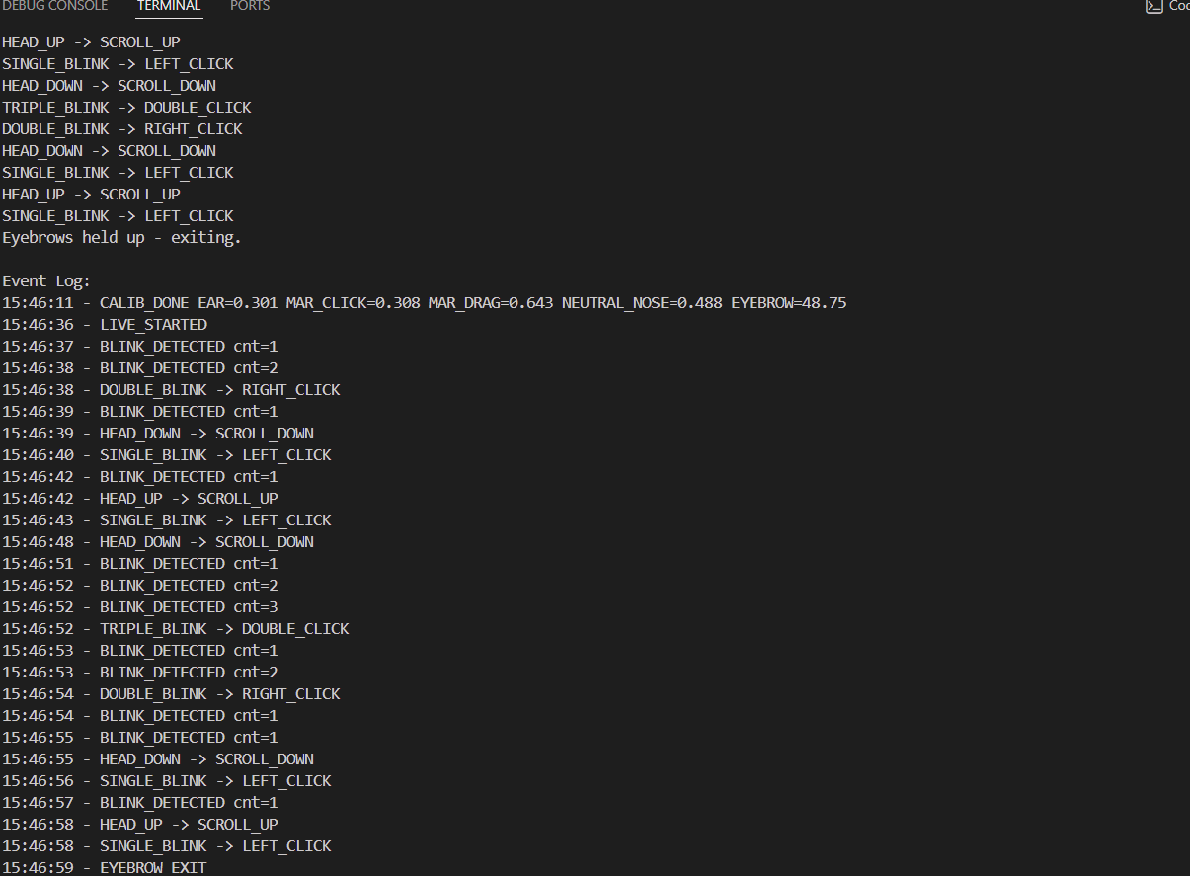
IMPLEMENTATION OF MODULE-4
1. Maps the predicted gestures to system actions such as mouse movement, left click, right click, and scrolling using pyautogui.
2. Dynamically controls the cursor position based on nose tip movement and toggles scroll mode via mouth opening.

Slide 14
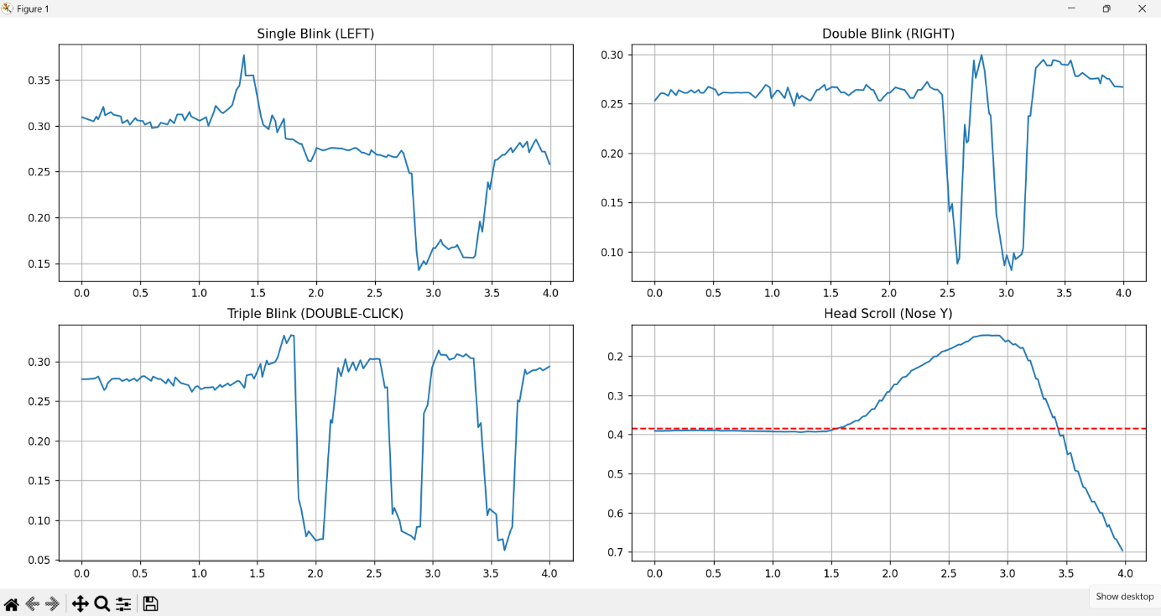
IMPLEMENTATION OF MODULE-5
1. Measures performance indicators such as calibration time, detection accuracy, and frames per second (FPS).
2. It evaluates response timing, gesture recognition stability, error rate, and generates performance graphs to conclude the system’s real-time usability.

Slide 15
CONCLUSION
1. The project develops a real-time facial gesture-based mouse control system that effectively captures, processes, and interprets user gestures with high precision. It replaces traditional input devices, offering a hands-free interaction method ideal for users with physical limitations.
2. By integrating computer vision and machine learning (LSTM model), the system ensures smooth and accurate cursor movement. It demonstrates the potential of AI-driven assistive technology to enhance accessibility, usability, and the overall human–computer interaction experience.

Slide 16
FUTURE ENHANCEMENTS
1. 3D Gesture Recognition: Future versions can incorporate 3D facial mapping to recognize depth-based gestures, allowing more complex and precise cursor movements.
2. Cloud-Based Processing: Integrating cloud computation can enable faster data processing and real-time gesture analysis without overloading local system resources.

